Slide 1
Work Area 3
Weekly Call September 14,2026
Summary Report on Luxembourg Workshop:
Strategy & Roll-Out Planning 2026-2027
Open. Sovereign. Scalable. Enterprise-ready.

Slide 2
Agenda September 10, 2026
Open. Sovereign. Scalable. Enterprise-ready.
Has been discussed in detail
Sovereign Services Strategy Discussion
Flinky Integration / Release Plan
Interoperability: Open Industry API / Marketplace <-> Sovereign Services
Tool Suite: AI compliance Suite / Flinky DevOps Components / Open Source Enterprise AI
White Label Packages
Has not been discussed in detail
Catch up will follow quickly in detail

Slide 3
Strategy Discussion

Slide 4
European Estimated Target Market Size
(Rough estimate – status July 2026)
Sources:
* Bitkom, Statista, IDC, European Commission, other internet sources
** aspect customer research
By no of customers*
30,000 to 45,000 small to medium-sized IT companies that provide
  ERP and specialized software providers
  System integrators
  Managed service providers
  Regional cloud providers.
Market size by revenue*
Addressing a core European market of approximately €180–250 billion and lowers the barriers to entry for medium-sized techn ology providers seeking to make productive use of generative AI.
Industry Challenges**
These companies have hundreds of products and thousands of customers but are often unable to economically provide model evaluation, GPU operations, compliance, monitoring, and multi-provider integration on their own.

Slide 5
AIODP strategic target customer groups
The AIODP/Foundation Model Hub strategy should focus on four target groups:
🏛️ Government & Public Sector and EU institutions
– need for sovereign, AI Act-compliant platforms.
🏭 Industry & Critical Infrastructure
– focus on secure, production-ready AI services.
💻 Software Vendors & System Integrators
– multipliers who integrate the platform into their solutions.
☁️ AI Factories & Cloud Infrastructure
- infrastructure partners that provide hosting, GPU, and inference services for the platform ecosystem.
This combination addresses both the direct demand for sovereign AI services and the development of a sustainable European ecosystem of partners and providers.

Slide 6
AIODP’s window of opportunity
Approx 20+ AI platforms in Europe offer various types of AI services
Despite this growing number of platforms, there is currently no European platform that brings together all essential building blocks to support industry in a single integrated ecosystem:
  a large, curated portfolio of open-source models,
  a Foundation Model Hub and OpenAI-compatible GenAI Gateway,
  federated GPU and inference services from European AI factories and industry partners,
  an AI Marketplace for applications and agents, compliance-by-design, low-code development,
  It is precisely this end-to-end integration that would serve as a
  strong unique selling proposition for the AIODP initiative in the European market.

Slide 7
AIODP Strategic Positioning
Open. Sovereign. Scalable. Enterprise-ready.
AIODP is positioned as a strategic entry point for sovereign AI services in Europe:
not merely as a catalog of models,
not merely as an inference platform
but as an open reference architecture for sovereign industrial AI services.
Open API standard
(European) Open Source Models
Sovereign Inference Operation
European Compliance
Enterprise ready operation
The key differentiator and USP lies in the combination of:

Slide 8


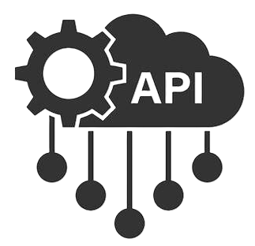

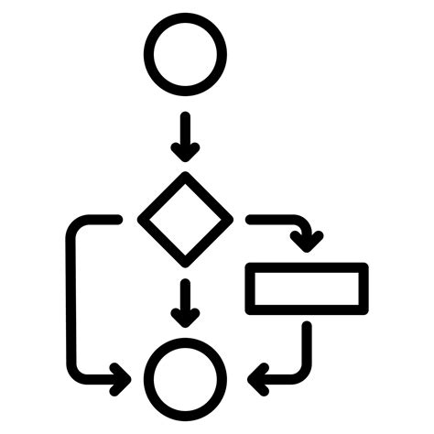





AIODP – High Level Solution Architecture
Available
AI-On-Demand-Platform (VirtoCommerce Open Source)
Roll-Out 2026/2027
Open-Source Marketplace
Sovereign AI Services
----------Model Layer----------
European AI Business Navigator
Open-Source Model Portfolio (LXP, FH, IONOS, LUMI)
----------Platform Layer----------
LXP-Flinky / Fraunhofer FMH
Business
AI Applications
Industrial
AI Applications
Vertical
AI Applications
European
AI Projects Ecosystem
----------Open API Layer----------
GenAI Gateway – Open AI Industry Bus
----------Tools Layer----------
DevOps
Agents
Compliance-by-Design
----------Service Layer----------
GPU-Hosting
Inference
Cloud

Slide 9
AIODP sovereign AI service architecture (I)
AIODP
Sovereign AI Services
Architecture
Blueprint to accelerate
European Industry’s
AI transformation process
----------Model Layer----------
Open-Source Model Portfolio (LXP, FH, IONOS, LUMI)
----------Platform Layer----------
LXP-Flinky / Fraunhofer FMH
----------Open API Layer----------
GenAI Gateway – Open AI Industry Bus
----------Tools Layer----------
DevOps
Agents
Compliance-by-Design
----------Service Layer----------
GPU-Hosting
Inference
Cloud

Slide 10
AIODP sovereign service architecture (II)
Model Layer
  Open-Source Model Portfolio
  European and international models
  LLMs, VLMs, embeddings, OCR, code models
  Model maps, license information, and evaluation data
Platform Layer
  AIODP Foundation Model Hub
  Model management
  Prompt engineering
  User interface for model comparison and prompt optimization
Open API Layer
  GenAI Gateway as a unified access layer
  OpenAI-compatible API
  Tool calling, structured outputs, embeddings, vision
Tools Layer
  DevOps
  Agents
  Compliance-by-Design
  Monitoring, logging, governance
Service Layer
  GPU Hosting
  Cloud and inference services
  AI factories and industrial providers
  On-demand or permanently hosted models

Slide 11
More to be discussed…
Impact of Hugging Face Acquisition
Status EuroHPC and other corresponding projects
Open Industry APIS
Role of Open-Source Models in the Industry / What’s next ?
Competitiveness of EuroHPC commercial offerings / Brokerage possible?
Competitive role of Compliance Tools / Political impact.
Competitive Role of Development Tools / AI Router, etc.
Other topics
Principal Positioning of AIODP in the European EU AND Market Context

Slide 12
Outcomes

Slide 13
FLINKY INTEGRATION / RELEASE PLAN
AIODP
Flinky platform: capabilities and release status
Applications and tools built on a sovereign execution layer
AVAILABLE
OCT. 2026
ROADMAP
APPLICATIONS
TOOLS
Corporate Chat
Oct 26 Release
Speech-to-Text & Translate
Oct 26 Release
AI Guardrails
Oct 26 Release
RAG
Roadmap
Model Fine-Tuning
Roadmap
AI Agents
Roadmap
Knowledge Graph
Roadmap
Blueprint
Roadmap
Knowledge Assistant
Roadmap
Model Benchmarking
Roadmap
FEATURES
CONSUMPTION
MODEL LIFECYCLE
OPERATIONS
Model Gateway
Available
Model Scheduling
Available
Monitoring & Observability
Available
Model-as-a-Service
Available
SDK for Application Integration
Available
CLI for Infrastructure Operations
Available
Deployment Recipes
Oct 26 Release
Shared Model
Available
Advanced Admin
Roadmap
Dynamic GPU Scaling
Available

Slide 14
AIODP Sovereign Services Integration under Flinky
2026 (Beta Phase)
Flinky
FrontEnd and Platform
for AIODP Sovereign Services
Q1-Q2 2027
Agentic Development Workflow Automation
YE 2027
White Label Portfolio
Inference Services Providers Connected
Meluxina
Lumi
Cloud/Kubernetes DevOps
Open Industry APIs Interoperability
Tools
Convotis
LuxProvide
Compliance/SALL, other
AI Builder
GenAI Gateway
Enterprise Portal
Other
Dedicated Use Cases
LightOn Console
Tools and Services Integration
AI Enterprise Suite Integration
Onboarding additional
HPCs/AI-Factories
Functional enhancements
AMD Suite
AI Builder ?
Combine with Kubernetes?
other
Capacity increase / Increase traffic
Competitive Positioning for Sovereignty
Marketplace
Flinky
Customization
Implementation
Support
Legal Entity Hand-Over

Slide 15
Planning Process / Call for action
Operational 2026 |  | Lead | Roll-Out Planning 2027 |  | Lead
Overall Flinky Integration Plan Flinky Release Plan | Scoping Paper Release Plan |  | Agentic Development Workflow Automation | Scoping Document
Cloud/Kubernetes <-> Flinky Integration | Scoping Paper Release Plan |  | AI Enterprise Suite Integration | Scoping Document
Marketplace <-> Flinky Interoperability & Integration Plan | Scoping Paper Release Plan |  | Onboarding of additional HPC / AI Factories | Scoping Document
Open Industry API From GenAI Gateway to Open Industry AI API Bus | Scoping Paper Release Plan |  | Open Industry API From GenAI Gateway to Open Industry AI API Bus | Scoping
AIODP Consolidated Front End Plan | Scoping Paper Release Plan |  | White Label Concepts (Marketplace, Flinky) | Draft
2026 Tools delivery (SALL, Compliance, AI Builder) | Scoping Paper Release Plan |  | Other functional enhancements | Proposals

Slide 16
Planning Process / Call for action
Prior to EU Review
Deadline
October 08, 2026
Planning Period Oct / Nov 2026
Deadline November 27, 2026
Operational 2026 |  | Lead | Roll-Out Planning 2027 |  | Lead
Overall Flinky Integration Plan Flinky Release Plan | Scoping Paper Release Plan | LXP | Agentic Development Workflow Automation | Scoping Document | LO
Cloud/Kubernetes <-> Flinky Integration | Scoping Paper Release Plan | LXP | AI Enterprise Suite Integration | Scoping Document | LXP/AMD
Marketplace <-> Flinky Interoperability & Integration Plan | Scoping Paper Release Plan | CO | Onboarding of additional HPC / AI Factories | Scoping Document | All / FBK
Open Industry API From GenAI Gateway to Open Industry AI API Bus | Scoping Paper Release Plan | ASP | Open Industry API From GenAI Gateway to Open Industry AI API Bus | Scoping | ASP
AIODP Consolidated Front And Plan | Scoping Paper Release Plan | 28D | White Label Concepts (Marketplace, Flinky) | Draft | LXP/CO
2026 Tools delivery (SALL, Compliance, AI Builder) | Scoping Paper Release Plan | ARC | Other functional enhancements | Proposals | FH

Slide 17
Call for action -> Kick-Off Calls tbd
 | Subject | Owner | Partner | Date
1 | Flinky Release Plan | LXP | asp, 28D, Convotis
2 | Cloud/Kubernetes Integration | LXP | CO, CSC
3 | Marketplace <-> SovServ common platform Model | CO | LXP, asp, 28D, asp
4 | AIODP Consolidated Front-End | 28D | CO, LXP, LO, asp, SciFy, Uhura
5 | Open Industry API | Asp | FH, LXP, AMD, Arc, CO, CSC
6 | 2026 Tools delivery | ARC | FH, AMD, LO, CSC

Slide 18
It is precisely an end-to-end integration that would serve as a
strong unique selling proposition for the
AIODP Sovereign Services initiative in the European market.
The Workarea 3 Team can make this happen!
So, LET’s Rock’n Roll

Slide 19
Backup

Slide 20
FLINKY INTEGRATION / RELEASE PLAN
AIODP
Flinky platform: Sovereign Agile Intelligence
The Vision
Why It Matters
Core Capabilities
The Agile Gateway to Digital Excellence.
Provide a fast and easy access to MeluXina’s computing power for organizations to run, prototype, build, and scale advanced AI
without compromising data sovereignty and security.
  Security and Sovereignty.
  100% Luxembourg-hosted, ISO 27001.
  Performance.
  500 PFLOPS dedicated AI power.
  Speed.
  Instant model-to-inference deployment.
Multimodal Inference.
Text, image, video, audio, and vision.
Tools
RAG and Knowledge Graphs.
Application
Corporate Chat
20
Letz Flink >
DeployAI WA3 2026_2027 Strategy & Roll-Out Planning | Luxembourg, September 10, 2026 | Private & Confidential

Slide 21
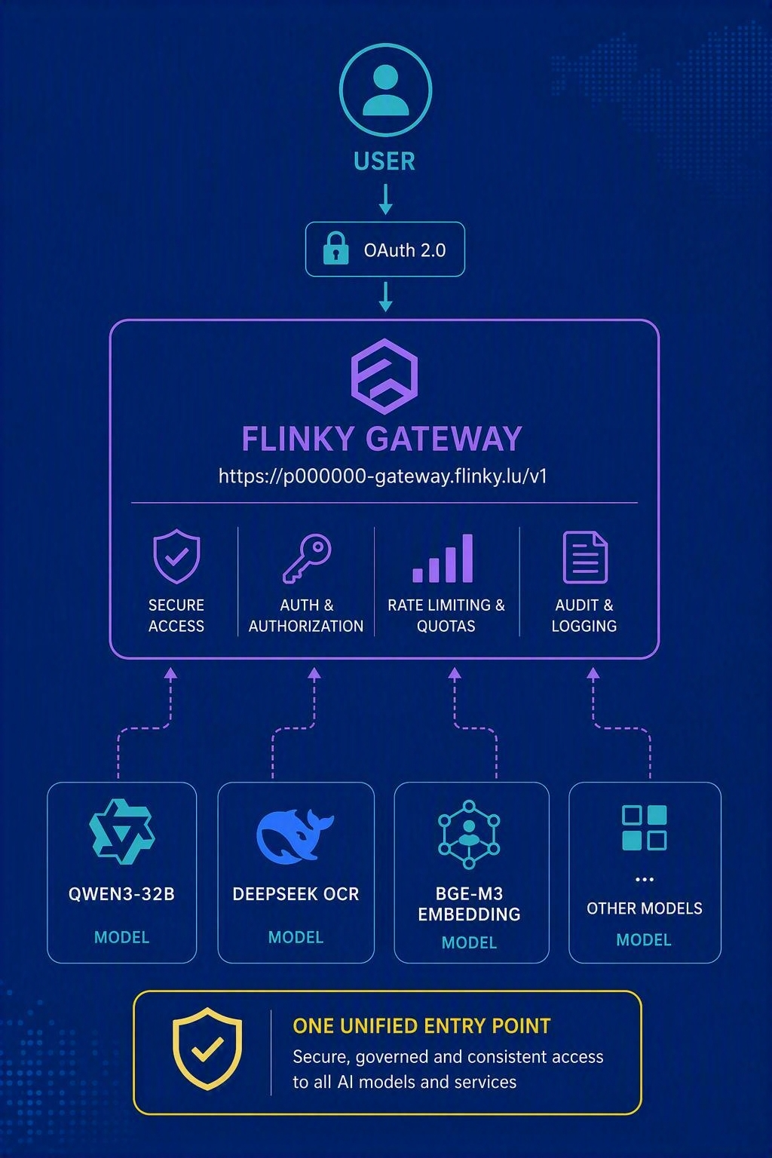
FEATURES | CONSUMPTION
AIODP
Model Gateway
AVAILABLE TODAY
WHY IT MATTERS
One endpoint for all AI models
OpenAI API compatible
OAuth 2.0 bearer-token authentication
Simple integration for applications and workflows
Flinky connects applications and workflows to ready-to-use sovereign AI models.
DeployAI WA3 2026_2027 Strategy & Roll-Out Planning | Luxembourg, September 10, 2026 | Private & Confidential

Slide 22
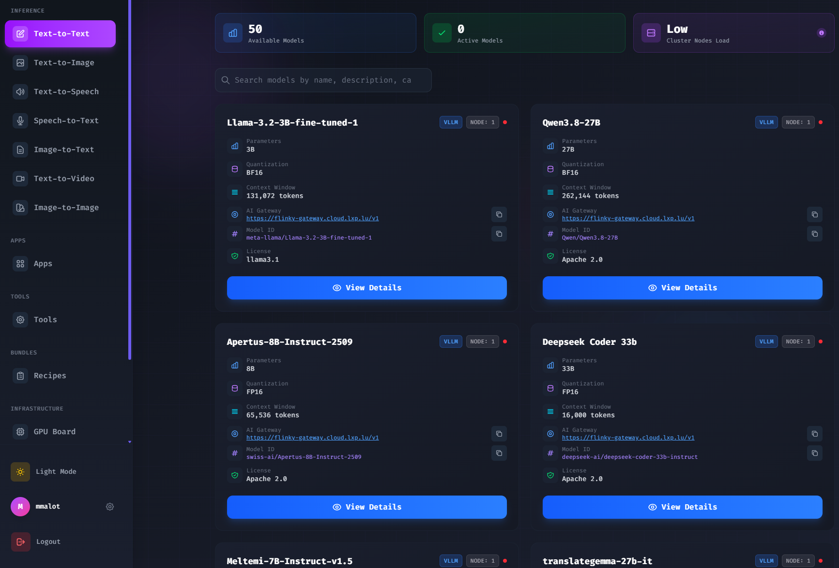
FEATURES | CONSUMPTION
AIODP
Models-as-a-Service
AVAILABLE TODAY
WHY IT MATTERS
Access 60+ AI models from one sovereign platform
Deploy in one click without infrastructure management
Cover LLMs, OCR, speech, image, video and embeddings
Powered by MeluXina HPC infrastructure
Flinky connects applications and workflows to ready-to-use sovereign AI models.
DeployAI WA3 2026_2027 Strategy & Roll-Out Planning | Luxembourg, September 10, 2026 | Private & Confidential

Slide 23
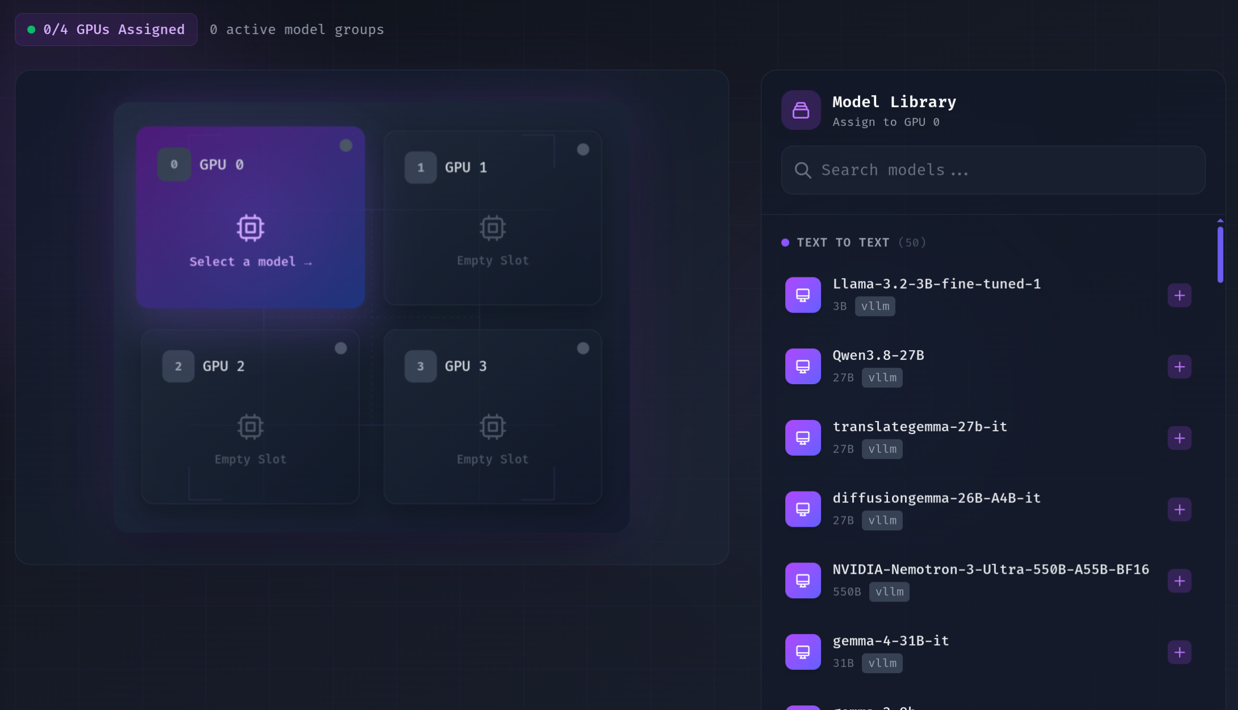
FEATURES | CONSUMPTION
AIODP
Deployment Recipes
RELEASE OCT. 2026
WHY IT MATTERS
Host several models on the same GPU node
Reduce idle capacity and operating costs
Simplify multi-model deployments
Preserve performance while increasing efficiency
Flinky connects applications and workflows to ready-to-use sovereign AI models.
DeployAI WA3 2026_2027 Strategy & Roll-Out Planning | Luxembourg, September 10, 2026 | Private & Confidential

Slide 24
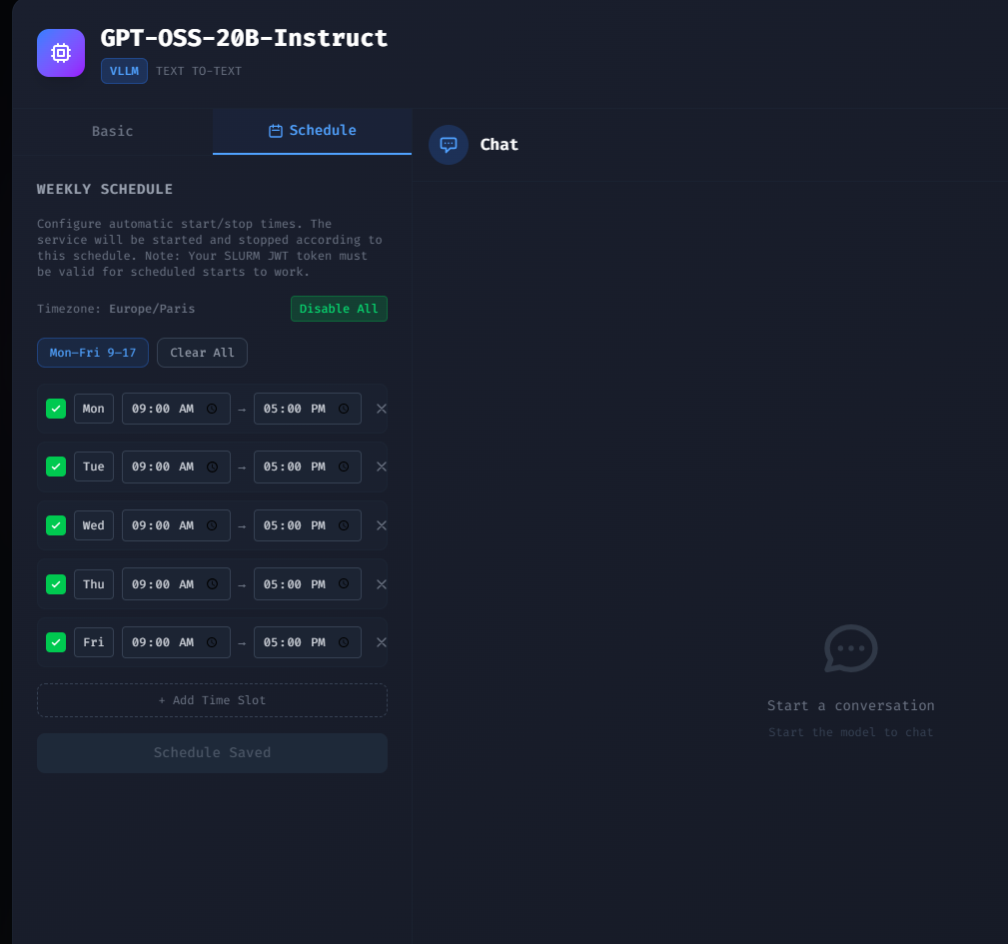
FEATURES | MODEL LIFECYCLE
AIODP
Model Scheduling
AVAILABLE TODAY
WHY IT MATTERS
Automate model start and stop times
Optimize GPU consumption and costs
Match capacity to business hours and peak demand
Avoid permanent resource allocation
Flinky connects applications and workflows to ready-to-use sovereign AI models.
DeployAI WA3 2026_2027 Strategy & Roll-Out Planning | Luxembourg, September 10, 2026 | Private & Confidential

Slide 25
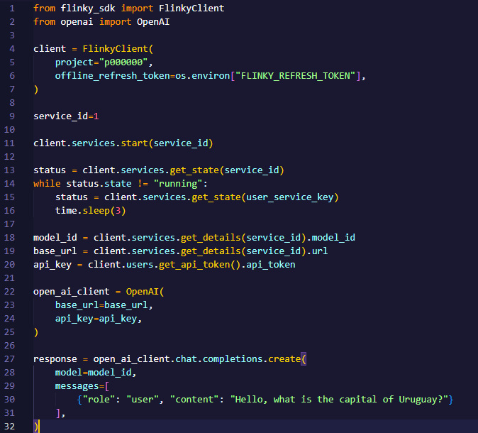
FEATURES | MODEL LIFECYCLE
AIODP
SDK for Application Integration
AVAILABLE TODAY
WHY IT MATTERS
Embed Flinky into applications and workflows
Automate and productionize AI operations
Use a Python SDK across Flinky capabilities
Integrate through OpenAI-compatible APIs
Flinky connects applications and workflows to ready-to-use sovereign AI models.
DeployAI WA3 2026_2027 Strategy & Roll-Out Planning | Luxembourg, September 10, 2026 | Private & Confidential

Slide 26
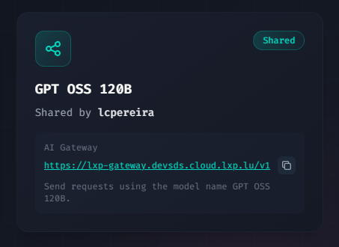
FEATURES | MODEL LIFECYCLE
AIODP
Shared Model
AVAILABLE TODAY
WHY IT MATTERS
Share models securely across teams
Promote reuse and collaboration
Eliminate duplicate deployments
Accelerate adoption across the organization
Flinky connects applications and workflows to ready-to-use sovereign AI models.
DeployAI WA3 2026_2027 Strategy & Roll-Out Planning | Luxembourg, September 10, 2026 | Private & Confidential

Slide 27
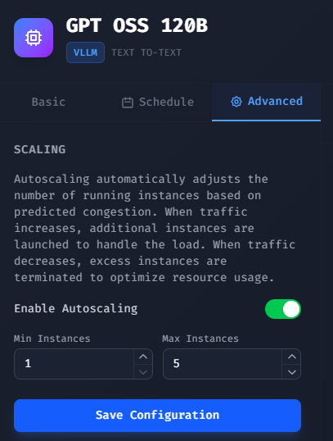
FEATURES | MODEL LIFECYCLE
AIODP
Dynamic GPU Scaling
AVAILABLE TODAY
WHY IT MATTERS
Adjust compute capacity to demand
Maintain availability during traffic spikes
Keep inference performance consistent at scale
Control consumption through configurable limits
Flinky connects applications and workflows to ready-to-use sovereign AI models.
DeployAI WA3 2026_2027 Strategy & Roll-Out Planning | Luxembourg, September 10, 2026 | Private & Confidential

Slide 28
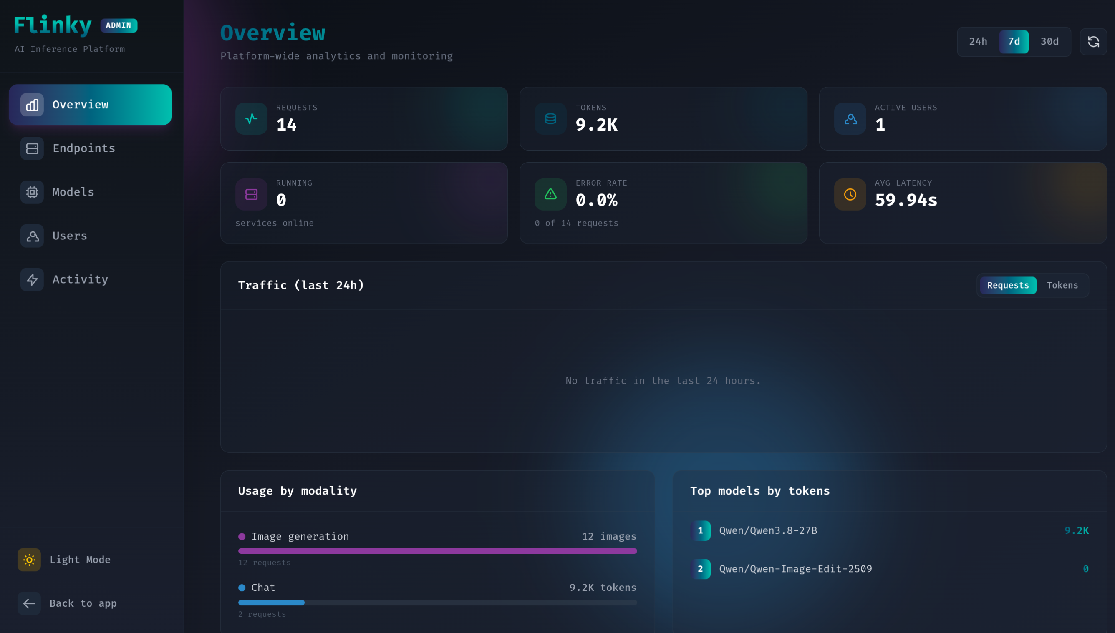
FEATURES | OPERATIONS
AIODP
Monitoring & Observability
AVAILABLE TODAY
WHY IT MATTERS
See models and instances across the organization
Track consumption and costs by user, team or model
Identify adoption trends and valuable use cases
Support governance, budgeting and capacity planning
Flinky connects applications and workflows to ready-to-use sovereign AI models.
DeployAI WA3 2026_2027 Strategy & Roll-Out Planning | Luxembourg, September 10, 2026 | Private & Confidential

Slide 29
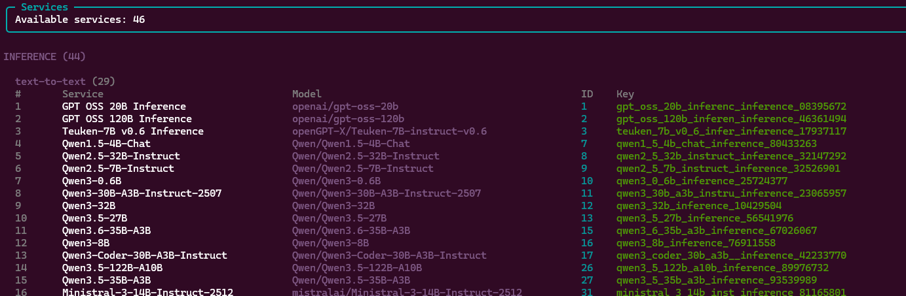
FEATURES | OPERATIONS
AIODP
CLI for Infrastructure Operations
AVAILABLE TODAY
WHY IT MATTERS
Start, stop and monitor models from the command line
Integrate with DevOps and CI/CD pipelines
Automate deployments and operations
Designed for administrators and MLOps teams
Flinky connects applications and workflows to ready-to-use sovereign AI models.
DeployAI WA3 2026_2027 Strategy & Roll-Out Planning | Luxembourg, September 10, 2026 | Private & Confidential

Slide 30
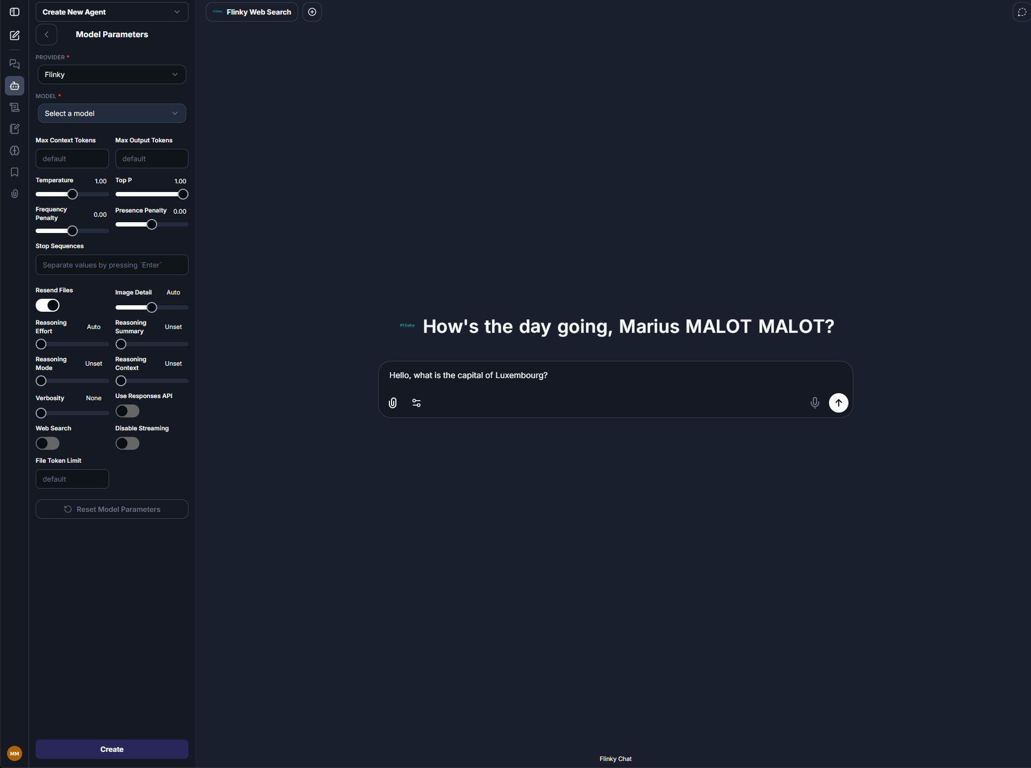
APPLICATION
AIODP
Corporate Chat
RELEASE OCT. 2026
WHY IT MATTERS
Secure enterprise assistant with conversation history
Analyze documents and uploaded files
Use multiple models from one interface
Create domain agents, skills and workflows
Flinky connects applications and workflows to ready-to-use sovereign AI models.
DeployAI WA3 2026_2027 Strategy & Roll-Out Planning | Luxembourg, September 10, 2026 | Private & Confidential

Slide 31
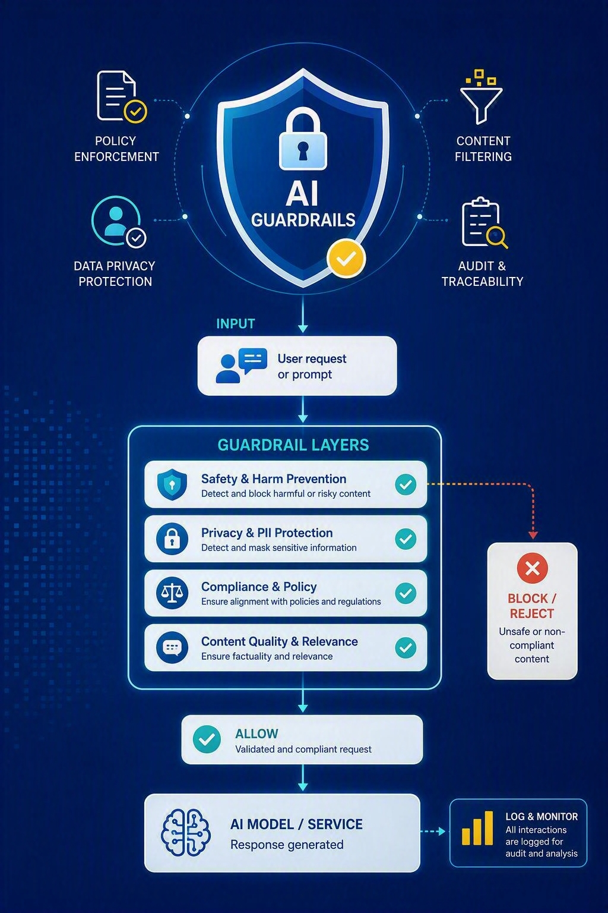
TOOLS
AIODP
AI Guardrails
RELEASE OCT. 2026
WHY IT MATTERS
Apply organizational policies across AI services
Prevent disclosure of sensitive information
Enforce consistent governance across models
Maintain traceability for compliance and risk
Flinky connects applications and workflows to ready-to-use sovereign AI models.
DeployAI WA3 2026_2027 Strategy & Roll-Out Planning | Luxembourg, September 10, 2026 | Private & Confidential

Slide 32
End of presentation

